Slide 1
Large Scale Data Processing --- Hadoop - MapReduce Features
Dr. Ramesh Ragala
VIT Chennai

Slide 2
Hadoop - MapReduce Features
Counters
Sorting
Joins
Side Data Distribution
Distributed Cache

Slide 3
Counter
Counters are used to help in getting statistics about the MapReduce job in Hadoop MapReduce.
For quality Control
For application-level statistics
Counters are also useful for problem diagnosis.
If the programmer is interested in to put log messages in map or reduce task, then counter is best option.
The counter values can be retrieved very easily than the log output for a large distributed jobs.

Slide 4
Counter: Types
There are two different types of counters are available in Hadoop-MapReduce.
Built-in Counters
User defined Counters

Slide 5
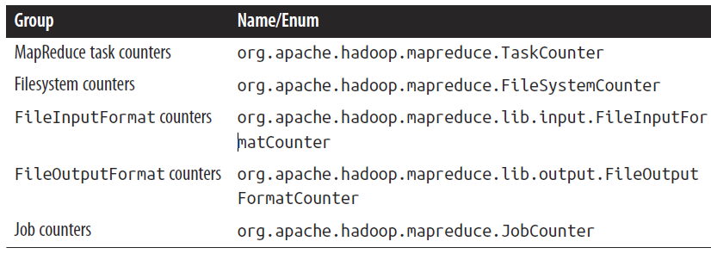
Built-in Counter
Hadoop maintains some built-in counters for every job.
Built-in Counters are divided into groups.
Each group either contains task counters or job counters.

Slide 6
Built-in Counter
Task Counters:
It gathers the information about the tasks during the execution of their execution and the results are aggregated over all the tasks in a job.
Example: MAP_INPUT_RECORDS counter → counts the input records read by each map task and aggregates over all map tasks in a job → the final figure is the total number of input records for the whole job.
Task counters are maintained by each task attempt.
It is periodically sends the report to the application master so they can be globally aggregated.

Slide 7
Built-in Counter
Task Counters:
Task counters are sent in full every time → this guards against errors due to lost messages.
Counter values are definitive only once a job has successfully completed.
However, it can also provides useful diagnostic information as a task is progressing.
These reports can be useful to monitor them with the web UI.
Example: PHYSICAL_MEMORY_BYTES, VIRTUAL_MEMORY_BYTES and COMMITTED_HEAP_BYTES. → memory usage of a task.

Slide 8
Built-in Counter
Task Counters:
Built-in task counters are available in
MapReduce task counters group
file-related counters groups ( Filesystem counters, FileInputFormat counters and FileOutputFormat counters)

Slide 9
Built-in Counter: MapReduce task Counters
Map input records (MAP_INPUT_RECORDS)
The number of records processed by all the maps.
Map output records (MAP_OUTPUT_RECORDS)
The number of output records emitted by all the maps.
Map skipped records (MAP_SKIPPED_RECORDS)
The number of records skipped by all the maps.
Map output bytes (MAP_OUTPUT_BYTES)
Output of all the maps in bytes.

Slide 10
Built-in Counter: MapReduce task Counters
Map output materialized bytes (MAP_OUTPUT_MATERIALIZED_BYTES)
Output bytes written to the disk.
Input split bytes (SPLIT_RAW_BYTES)
Metadata about the input splits in bytes.
Combine input records (COMBINE_INPUT_RECORDS)
The number of input records processed by combiner.
Combine output records (COMBINE_OUTPUT_RECORDS)
The number of output records emitted by combiner.

Slide 11
Built-in Counter: MapReduce task Counters
Reduce input groups (REDUCE_INPUT_GROUPS)
The number of key groups processed by all the Reducers.
Reduce shuffle bytes (REDUCE_SHUFFLE_BYTES)
Map output copied to Reducers in bytes.
Reduce input records (REDUCE_INPUT_RECORDS)
The number of input records processed by all the Reducers.
Reduce output records (REDUCE_OUTPUT_RECORDS)
The number of output records emitted by all the Reducers.
Reduce skipped records (REDUCE_SKIPPED_RECORDS)
The number of records skipped by Reducer.

Slide 12
Built-in Counter: MapReduce task Counters
Spilled Records (SPILLED_RECORDS)
The number of records spilled to the disk.
Shuffled Maps (SHUFFLED_MAPS)
The number of map output files copied to nodes where reducers are running.
Failed Shuffles (FAILED_SHUFFLE)
The number of map output files failed during shuffle.
Merged Map outputs (MERGED_MAP_OUTPUTS)
The number of map outputs merged to create input for the Reducers.

Slide 13
Built-in Counter: MapReduce task Counters
GC time elapsed (GC_TIME_MILLIS)
Time spent in garbage collection.
CPU time spent (CPU_MILLISECONDS)
CPU time spent for task processing.
Physical memory snapshot (PHYSICAL_MEMORY_BYTES)
Total physical memory used.
Virtual memory snapshot (VIRTUAL_MEMORY_BYTES)
Total virtual memory used.
Total committed heap usage (COMMITTED_HEAP_BYTES)
Total amount of heap memory available.

Slide 14
Built-in Counter: Filesystem Counters
Number of bytes read (BYTES_READ)
It shows the number of bytes read by Map and Reduce tasks.
There will be a separate counter for each file system (Local File system, HDFS, S3, etc.)
Number of bytes written (BYTES_WRITTEN)
It shows the number of bytes written by Map and Reduce tasks.
Number of read operations (READ_OPS)
It shows the number of read operations by both Map and Reduce tasks.
Number of large read operations (LARGE_READ_OPS)
It shows the number of large operations by both Map and Reduce tasks.
Number of write operations (WRITE_OPS)
It shows the number of write operations by both Map and Reduce tasks.

Slide 15
Built-in Counter: FileInputFormat Counters
Bytes Read (BYTES_READ)
Bytes read by Map tasks using the Input format used for the task.

Slide 16
Built-in Counter: FileOutputFormat Counters
Bytes Written (BYTES_WRITTEN)
Bytes written by Map and reduce tasks using the Output format used for the task.

Slide 17
Built-in Counter: Job Counters
Job counters are maintained by the application master, so they don’t need to be sent across the network.
It measures the job-level statistics → not values that change while a task is running.
Launched map tasks (TOTAL_LAUNCHED_MAPS)
Total number of launched map tasks.
Launched reduce tasks (TOTAL_LAUNCHED_REDUCES)
Total number of launched reduce tasks.

Slide 18
Built-in Counter: Job Counters
Failed map tasks (NUM_FAILED_MAPS)
The number of failed map tasks.
Failed reduce tasks (NUM_FAILED_REDUCES)
The number of failed reduce tasks.
Killed map tasks (NUM_KILLED_MAPS)
The number of killed map tasks.
Killed reduce tasks (NUM_KILLED_REDUCES)
The number of killed reduce tasks.
Data-local map tasks (DATA_LOCAL_MAPS)
The number of map task running on the same node where the data they process also resides.
rack-local map tasks (RACK_LOCAL_MAPS)
The number of map task running on the node in the rack where the data they process also resides.
Launched uber tasks (TOTAL_LAUNCHED_UBERTASKS)
Total number of launched uber tasks.

Slide 19
Built-in Counter: Job Counters
Map in uber tasks (NUM_UBER_SUBMAPS)
The number of maps run as uber task.
Reduce in uber tasks (NUM_UBER_SUBREDUCES)
The number of reduces run as uber task.
failed uber tasks (NUM_FAILED_UBERTASKS)
The number of failed uber tasks.
Total time spent by all map tasks (ms) (MILLIS_MAPS)
Time spent in running all the map tasks.
Total time spent by all reduce tasks (ms) (MILLIS_REDUCES)
Time spent in running all the reduce tasks.
Total vcore-milliseconds taken by all map tasks (VCORES_MILLIS_MAPS)
Total Vcore time taken by all map tasks.
Total vcore-milliseconds taken by all reduce tasks (VCORES_MILLIS_REDUCES)
Total Vcore time taken by all reduce tasks.

Slide 20
User-defined Counter
MapReduce allows user code to define a set of counters.
These counters also helps for debugging.
Example: Create a counter and increment it for some condition and then check the counter output. → that will also gives an idea if there is anything wrong with the data.
Counters are defined by a Java enum, which serves to group related counters.
A job may define an arbitrary number of enums, each with an arbitrary number of fields.
The name of the enum is the group name, and the enum fields are the counter names.
Counters are global: the MapReduce framework aggregates them across all maps and reduces to produce a grand total at the end of the job.
Java enum’s fields are defined at compile time → Dynamic Counters

Slide 21
User-defined Counter
Two ways to create user-defined counters:
Java Enum’s
Using Strings
Enums are easier to work with, provide type safety, and are suitable for most jobs.
In few occasions when the programmers needs to create counters dynamically, then String interface can be used. It is bit complex than Java Enum’s.
The counter information can be checked in Web UI and also using command line.

Slide 22
References:
Hadoop: The Definitive Guide 4th Edition by Tom White
https://knpcode.com/hadoop/mapre duce/counters-in-hadoop-mapreduce/
https://www.netjstech.com/2018/07/what-are-counters-in-hadoop-mapreduce.html
The simple Java MapReduce code is also provided for finding missing records in the above URL links. Please execute the program.

Slide 23
Sorting
The ability to sort data is at the heart of MapReduce.
Even the application is not concern with sorting, still it may be able to use the sorting stage that MapReduce provides to organize its data.
Now, different ways of sorting datasets and control on the sort order in MapReduce will be discussed.
Example: Application related to find the average of the temperature. If the temperature is taking as a key and stored as Text object, then it is difficult to do sorting. Because, temperature may be in negative. Hence, Sequence File concept is used. In this IntWritable keys represent the temperature and whose Text values are the lines of data.
By default, MapReduce will sort the input records by their keys.

Slide 24
Sorting
In the following examples, weather dataset by temperature.
Storing temperatures as Text objects doesn’t work for sorting purposes. → negative temperature gives problem while doing lexicographically.
Now, store the dataset using sequence file. → IntWritable keys represent the temperatures and Text values are the lines of data. → it gives a variation for sorting sequence files with IntWritable keys.
Controlling Sort Order: The sort order for keys is controlled by a RawComparator, which is found as follows:
If the property mapreduce.job.output.key.comparator.class is set, either explicitly or by calling setSortComparatorClass() on Job, then an instance of that class is used.
Otherwise, keys must be a subclass of WritableComparable, and the registered comparator for the key class is used.
If there is no registered comparator, then a RawComparator is used. The RawComparator deserializes the byte streams being compared into objects and delegates to the WritableComparable’s compareTo() method.

Slide 25
Sorting: Partial Sorting
Suppose, if the program is executed with 30 reducer tasks (Assume 30 partitioners in the program ) then the program produces 30 different reduces.
The key-value pair in each reducer will obey the sorting principle.
But the globally, ( i.e key-value pairs of all reducer) will not obey the sorting principle. → This is a one of the challenging problems .
Simply, there is no easy way to combine the files (reduce files) to produce a globally sorted file.
For example, having a partially sorted set of files is fine when you want to do lookups by key.
Hence, MapFile format is best to represent dataset. Because it is possible to first find the relevant partition that a key belongs in (using the partitioner), then to do an efficient lookup of the record within the map file partition. → This procedure is treated as partial sorting.

Slide 26
Sorting: Total Sorting
How can you produce a globally sorted file using Hadoop?
The single answer for this problem is “ use single or one partition”.
If the dataset is too large and MapReduce is on single machine (Pseudo mode), then it is difficult. (missing parallelism)
Instead, it is possible to produce a set of sorted files that, if concatenated, would form a globally sorted file.
The idea to doing this is to use a partitioner that respects the total order of the output.
Example:
if we had four partitions, we could put keys for temperatures < –10°C in the first partition, those temperature > –10°C and temperature < 0°C in the second, those between 0°C and 10°C in the third, and those over 10°C in the fourth.
What is the problem in the scenario??. It will works well. But few problems.

Slide 27

Sorting: Total Sorting
We have to choose the partition sizes carefully to ensure that they are fairly even, so job times aren’t dominated by a single reducer.
For the discussed example, the partitioning scheme may follow like this
These partitions are not very even.
To construct more even partitions, we need to have a better understanding of the temperature distribution for the whole dataset.
It’s fairly easy to write a MapReduce job to count the number of records that fall into a collection of temperature buckets.
Although we could use this information to construct a very even set of partitions, the fact that we needed to run a job that used the entire dataset to construct them is not ideal.

Slide 28

Sorting: Total Sorting
Another Solution:
It’s possible to get a fairly even set of partitions by sampling the key space.
The idea behind sampling is that you look at a small subset of the keys to approximate the key distribution, which is then used to construct partitions.
We do not need to write the code for this sampling. → Hadoop provides to use.
The InputSampler class defines a nested Sampler interface whose implementations return a sample of keys given an InputFormat and Job:
writePartitionFile() static method on InputSampler is used, which creates a sequence file to store the keys that define the partitions and provides the access to the sampler interface.

Slide 29

Sorting: Total Sorting
We use a RandomSampler, which chooses keys with a uniform probability, 0.1.
There are also parameters for the maximum number of samples to take and the maximum number of splits to sample, and the sampler stops when the first of these limits is met.
The time taken to run the sampler is a small fraction of the overall job time.
After using InputSampler on the weather dataset, then it will distribute the data as follows with partitioner.
The input data determines the best sampler to use.
RandomSampler is a good general-purpose sampler.
IntervalSampler chooses keys at regular intervals through the split and makes a better choice for sorted data.
We can write our own Sampler interface for our input dataset.
One of the nice properties of InputSampler and TotalOrderPartitioner is that you are free to choose the number of partitions—that is, the number of reducers.

Slide 30
Sorting: Secondary Sorting
As we know that, MapReduce framework sorts the records before reaching the reducer.
For any particular key, however, the values are not sorted.
The order in which the values appear is not even stable from one run to the next, because they come from different map tasks, which may finish at different times from run to run.
Most MapReduce programs are written so as not to depend on the order in which the values appear to the reduce function.
However, it is possible to impose an order on the values by sorting and grouping the keys in a particular way.

Slide 31
Sorting: Secondary Sorting
Composite Key
Natural Key
Secondary Key
Example:
A MapReduce program for calculating the maximum temperature for each year.
If we arranged for the values (temperatures) to be sorted in descending order, we wouldn’t have to iterate through them to find the maximum;
Another way, we could take the first for each year and ignore the rest.
Solution: Secondary Sorting
Change the keys to composite: → A Combination of year and temperature
The task is → we want the sort order for keys to be by year (ascending) and then by temperature (descending)
In this , we have changed the key to composite key. Still it will not help to get our goal.
The records for the same year would have different keys and therefore would not go to the same reducer. Example: (1900, 35C) and (1900,34C) may not go to same reducer.
Solution: Set a partitioner to partition by the year part of the key, we can guarantee that records for the same year go to the same reducer.

Slide 32
Sorting: Secondary Sorting
This still isn’t enough to achieve our goal, however.
A partitioner ensures only that one reducer receives all the records for a year;
it doesn’t change the fact that the reducer groups by key within the partition:
The final piece of the puzzle is the setting to control the grouping.
If we group values in the reducer by the year part of the key, we will see all the records for the same year in one reduce group.
And because they are sorted by temperature in descending order, the first is the maximum temperature:
Summary:
Make the key a composite of the natural key and the natural value.
The sort comparator should order by the composite key (i.e., the natural key and natural value).
The partitioner and grouping comparator for the composite key should consider only the natural key for partitioning and grouping.

Slide 33
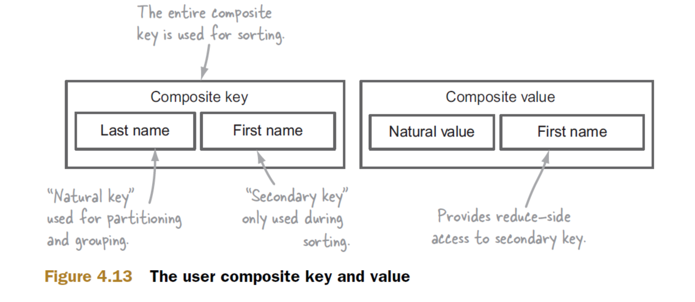
Sorting: Secondary Sorting
Another Example:

Slide 34
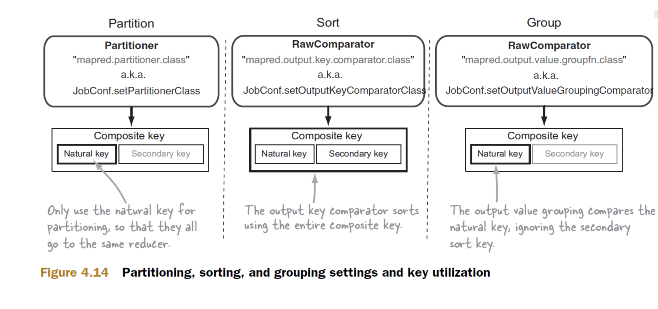
Sorting: Secondary Sorting
Another Example (Continue):

Slide 35
References:
Hadoop: The Definitive Guide 4th Edition by Tom White
https://medium.com/@sudarshan_sreenivasan/what-is-secondary-sort-in-hadoop-and-how-does-it-work-fe35609b5319
http://blog.ditullio.fr/2015/12/28/hadoop-basics-secondary-sort-in-mapreduce/
https://www.zaloni.com/resources/blogs/secondary-sorting-in-hadoop-2/
Please execute the program in the above links

Slide 36
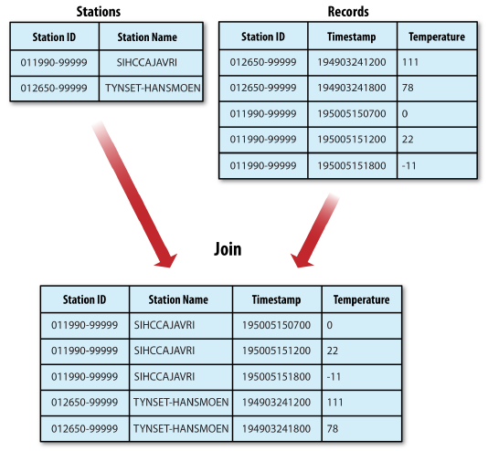
Joins
MapReduce can perform joins between large datasets.
Code has to be write from the scratch.
Example: we have two datasets → weather stations database and the weather records. → problem: check each station’s history, with the station’s metadata in-lined in each output row.

Slide 37
Joins
The implementation of Join in MapReduce can be depends on
How large the datasets are…
How they are partitioned…
If one dataset is large and another dataset is small enough to distributed to each node in a cluster, the join can be effected by a MapReduce job that brings the records for each station together.
In this case, the mapper or reducer uses the small dataset to look up. (Side Data Distribution, Distributed Cache Mechanism)
If Join operation is performed by mapper, then it is called a Map-Side Join.
If join operation is performed by reducer then it is called a Reduce-Side Join.
The above two different types of joins depends upon the structure of the data.
Example: A user database and a log of some user activity (such as access logs). it is not feasible to distribute the user database (or the logs) to all the MapReduce nodes.

Slide 38
Joins: Map-side Join
The inputs to each mapper must be partitioned and sorted in a particular way. → Each input dataset must be divided into the same number of partitions, and it must be sorted by the same key (the join key) in each source.
All the records for a particular key must reside in the same partition.
A map-side join can be used to join the outputs of several jobs that had the same number of reducers, the same keys, and output files that are not splittable.
Example: weather example → we ran a partial sort on the stations file by station ID, and another identical sort on the records, again by station ID and with the same number of reducers, then the two outputs would satisfy the conditions for running a map-side join.
CompositeInputFormat from the org.apache.hadoop.mapreduce.join package can be used to run a map-side join.

Slide 39
Joins: Reduce-side Join
It is more general than map-side joins. i.e input data don’t need to be structured.
It is less efficient, because both datasets have to go through the MapReduce shuffle.
Basic idea: The mapper tags each record with its source and uses the join key as the map output key, so that the records with the same key are brought together in the reducer.
There are several ways to implement the basic idea:
Multiple Input:
The input sources for the datasets generally have different formats, so it is very convenient to use the MultipleInputs class to separate the logic for parsing and tagging each source.
Secondary Sorting:
The reducer will see the records from both sources that have the same key, but they are not guaranteed to be in any particular order.
However, to perform the join, it is important to have the data from one source before that from the other.

Slide 40
References:
Hadoop: The Definitive Guide 4th Edition by Tom White
https://www.edureka.co/blog/mapreduce-example-reduce-side-join/
https://www.guru99.com/introduction-to-counters-joins-in-map-reduce.html
https://www.h2kinfosys.com/blog/hadoop-mapreduce-join-counter-with-example/
Execute the program specified in the above links

Slide 41
Side Data Distribution
Side data can be defined as extra read-only data needed by a job to process the main dataset.
Challenge: To make a side data to all map and reduce tasks in a convenient and efficient way.
We can set arbitrary key-value pairs in the job configuration using the various setter methods on Configuration.
This approach is very useful to pass a small piece of metadata to your tasks.
In the task, you can retrieve the data from the configuration returned by Context’s getConfiguration() method.
A primitive type is sufficient to encode the metadata. But for arbitrary objects either serialization or Hadoop’s Stringifier class can be used.
This mechanism for transferring more than a few kilobytes of data, because it can put pressure on the memory usage in MapReduce components.

Slide 42
Distributed Cache
Rather than serializing side data in the job configuration, it is preferable to distribute datasets using Hadoop’s distributed cache mechanism.
This provides a service for copying files and archives to the task nodes in time for the tasks to use them when they run.
To save network bandwidth, files are normally copied to any particular node once per job.
you can specify the files to be distributed as a comma-separated list of URIs as the argument to the-files option.
Files can be on the local filesystem, on HDFS, or on another Hadoop readable filesystem (such as S3).

Slide 43
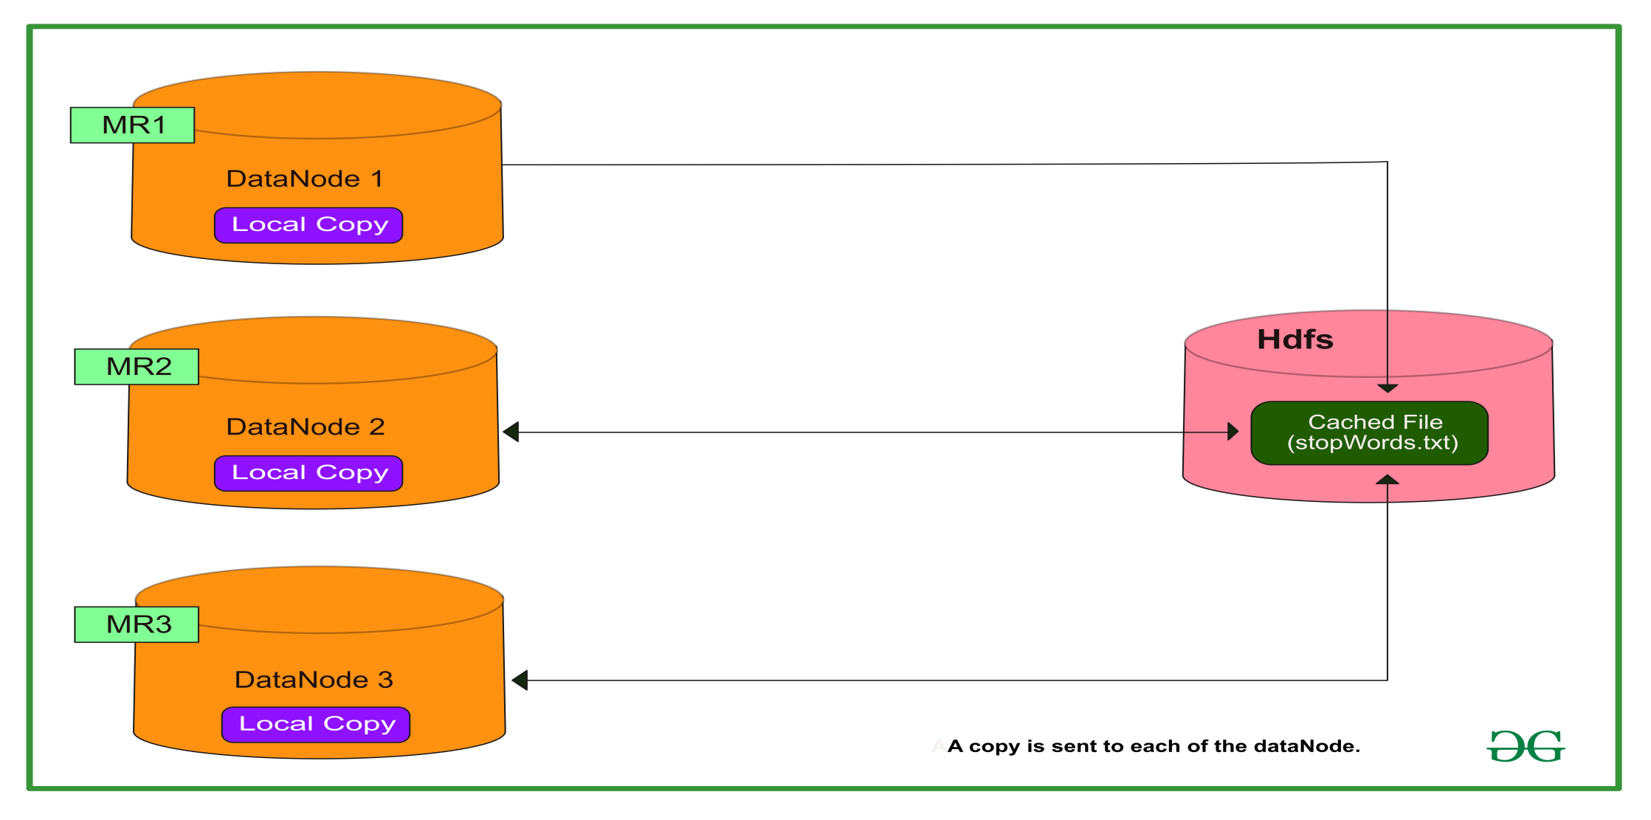
Distributed Cache

Slide 44
Distributed Cache
When the user launches a job, Hadoop copies the file specified as arguments in –files, -archives, -libjars to HDFS.
Before running the task, the NodeManager copies these files from HDFS to local disk — cache.
It does this so that the task can now access these files.
At this point, the file gets tagged as localized.
From the task’s point of view, the files are symbolically linked to the task’s working directory.
The NodeManager maintains a count for the number of tasks using these localized files.
Before running the task the counter increases by one.
And after the task finish execution, the counter gets decremented by one.
The file is eligible for deletion only when there are no tasks using it.
The file gets deleted when the cache size exceeds a certain limit like 10GB (default).

Slide 45
References:
Hadoop: The Definitive Guide 4th Edition by Tom White
https://medium.com/@bharvi.vyas123/distributed-cache-in-hadoop-how-distributed-cache-works-8f7996e179f9
https://techvidvan.com/tutorials/distributed-cache-in-hadoop/
https://www.netjstech.com/2018/07/distributed-cache-in-hadoop-mapreduce.html
Execute the program specified in the above links

Slide 46


